Slide 1
A Galactic Gamma Ray Signature for Axions
Possible axion line emission from ²³Na deposits in evolved massive stars
Wick Haxton,^{(LBL, UCB)} Xing Liu,^{(UCB)} and Anupam Ray ^{(UCB)}
Contact: xingyzt@berkeley.edu
¹H
¹⁶O ²⁰Ne ²³Na ²⁴Mg
B
⁴He
a
γ

Slide 2
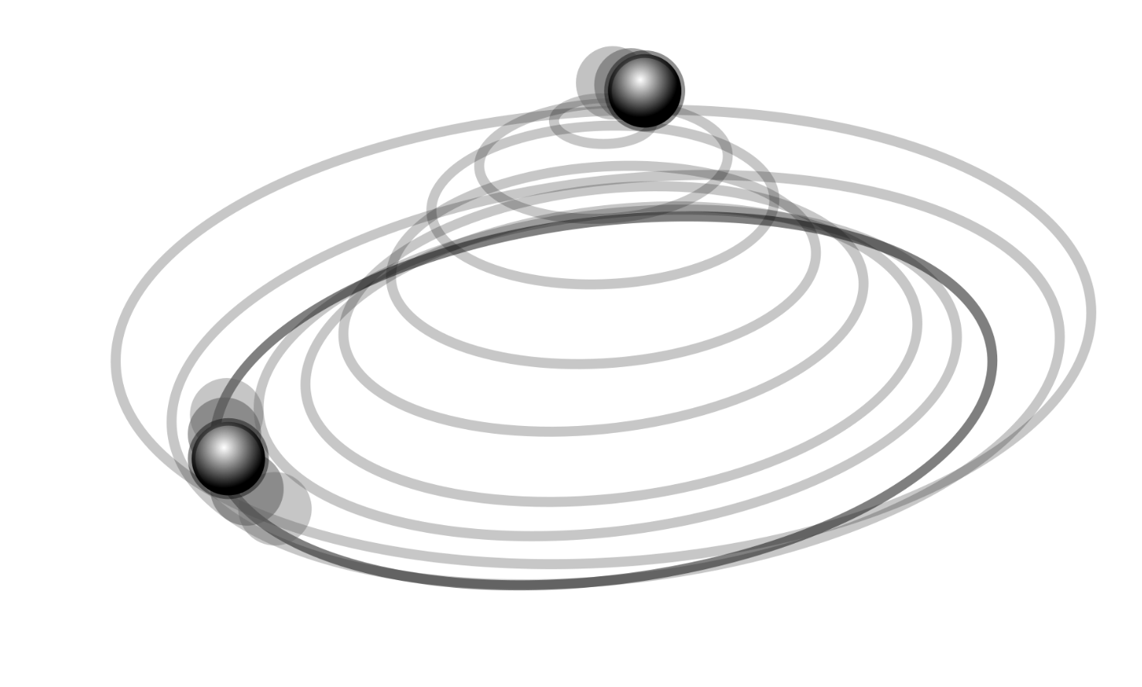
1. Motivation
The Peccei–Quinn axion is one of the most elegant explanations for why experiments find the CP-violating term in QCD vanishingly small.
Weakly interacting and produced in abundance by symmetry breaking, axion-like particles are also promising candidates for cold dark matter.
Symmetry breaking in the early universe creates cold axions suitable for galaxy formation
Axion vacuum realignment suppresses CP violation in the neutron electric dipole moment
(Raffelt 2008)
Notes:
* Axions one of the best motivated suggestions for physics beyond the SM
* very attractive DM candidate, copiously produced in the Big Bang
* connected to one of the most elegant proposals to explain why the
neutron edm is so small
* Many searches have been done: now established that axion couplings to matter are very weak
* detecting axions will be challenging!

Slide 3
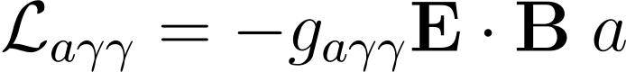
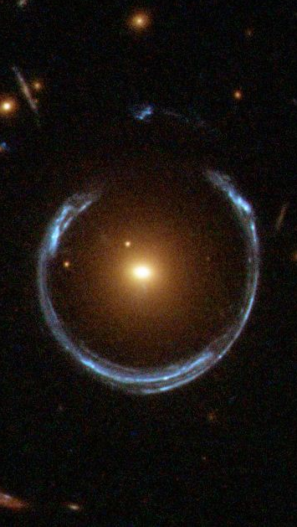
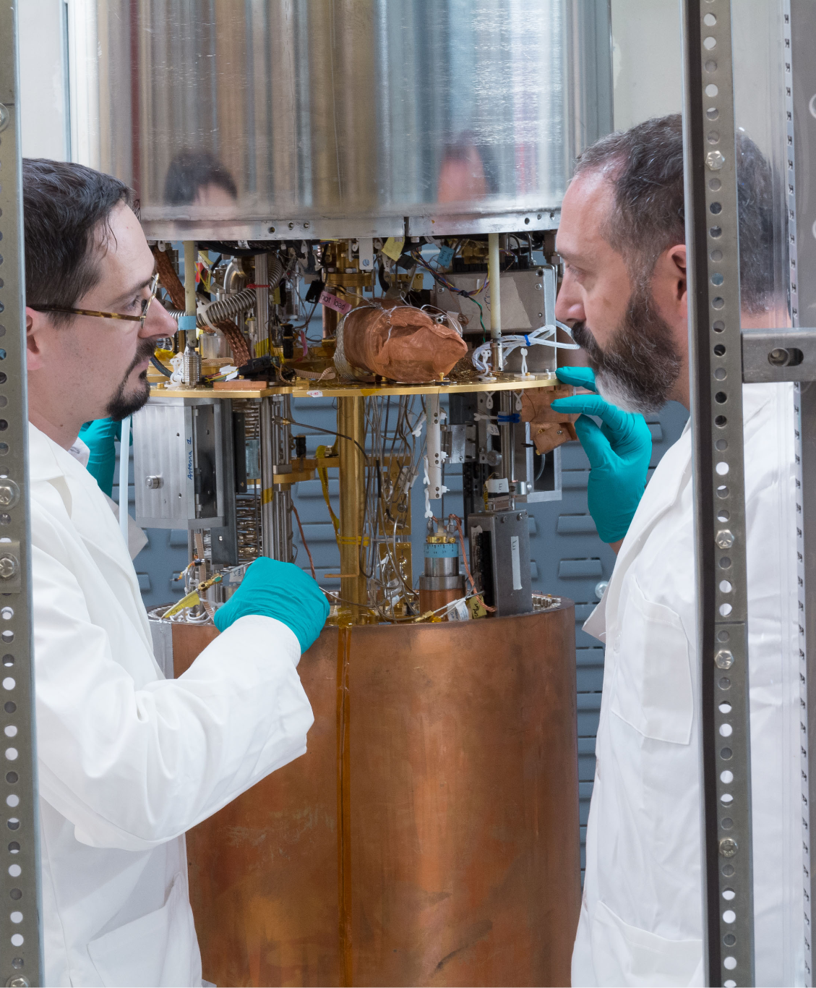
2. Photon interaction
Axion-photon coupling
Axion field
External B field
γ
Microwave signal
γ
Halo axion
a
Milky Way halo
Magnetic conversion
Haloscopes
Image: NASA; UW/ADMX
(Raffelt 2008)
Notes:
Cosmological axions dark matter halos

Slide 4
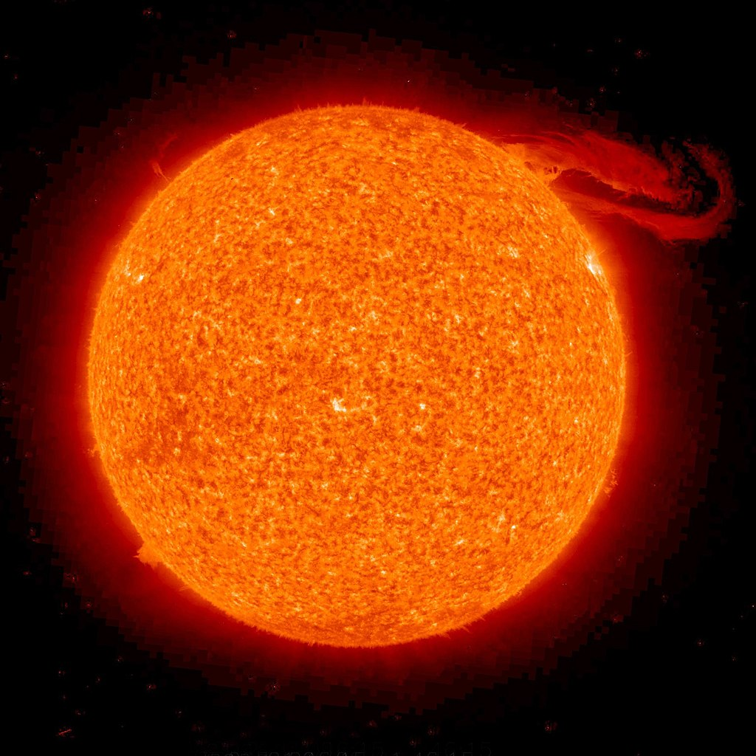
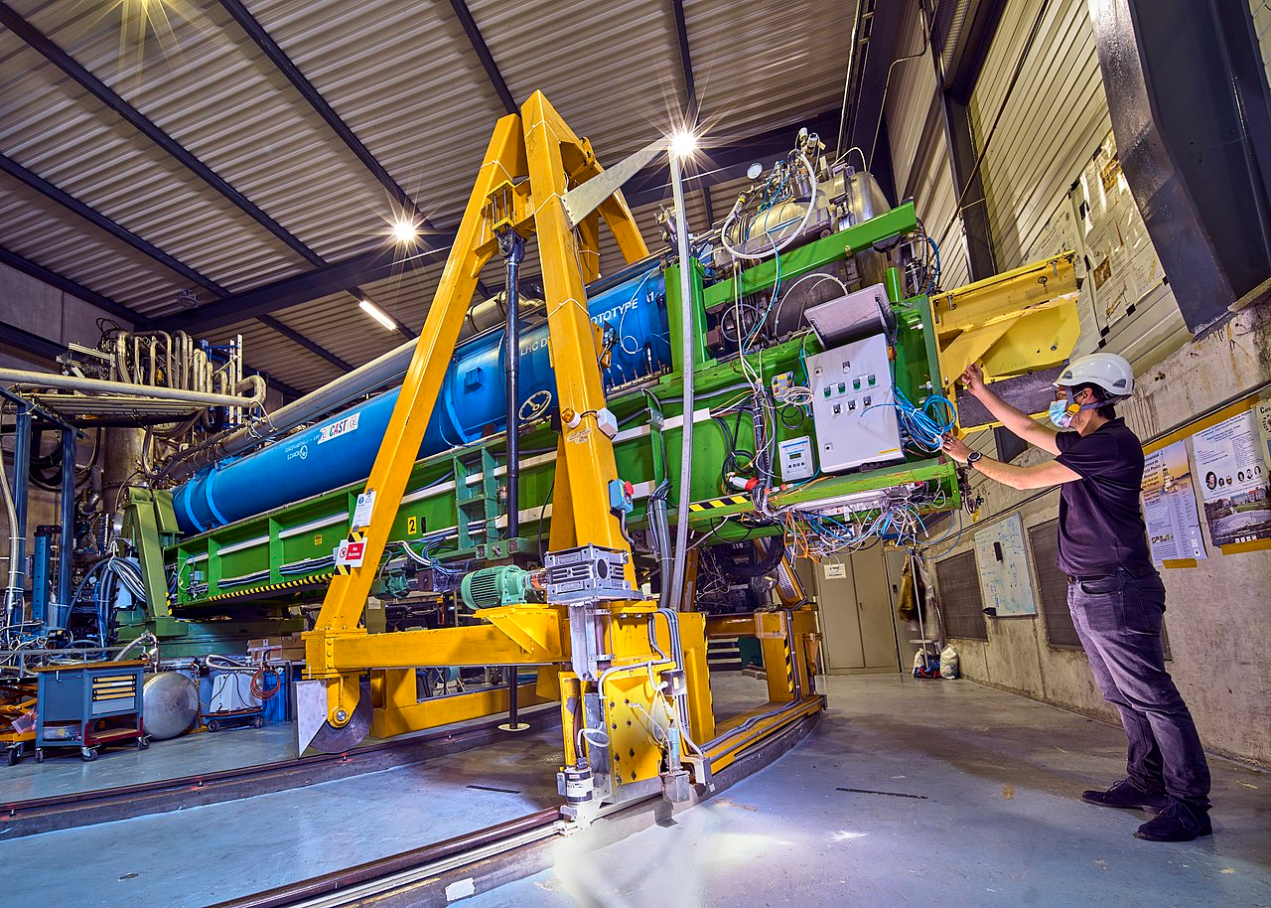
2. Photon interaction
Axion-photon coupling
Axion field
N
N
Nucleon
γ
Gamma ray
Solar axion
γ
a
Sun interior
Primakoff effect
Helioscopes
(Raffelt 2008)
Image: NASA; CERN/Brice Maximilien

Slide 5
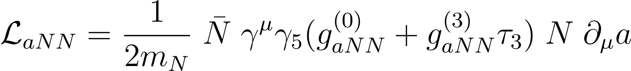
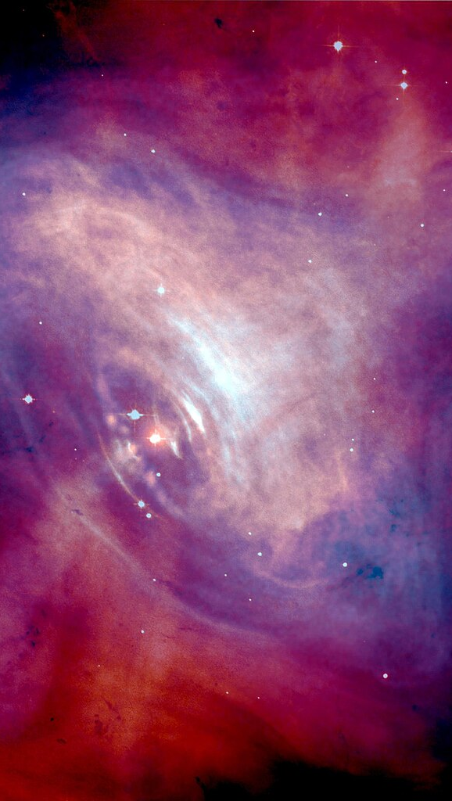
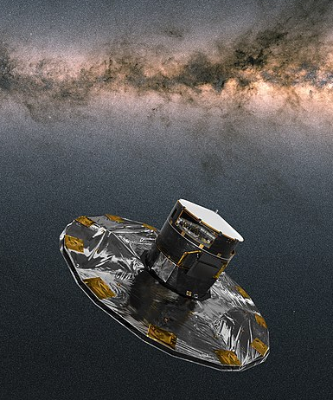
Isoscalar coupling
Isovector coupling
Nucleon isospin doublet
3. Nucleon interaction
N
N
π⁰
N
N
a
Stellar remnants
Nuclear bremsstrahlung
Photometric surveys
Image: NASA; ESA/A. Moitinho
(Raffelt 2008)

Slide 6
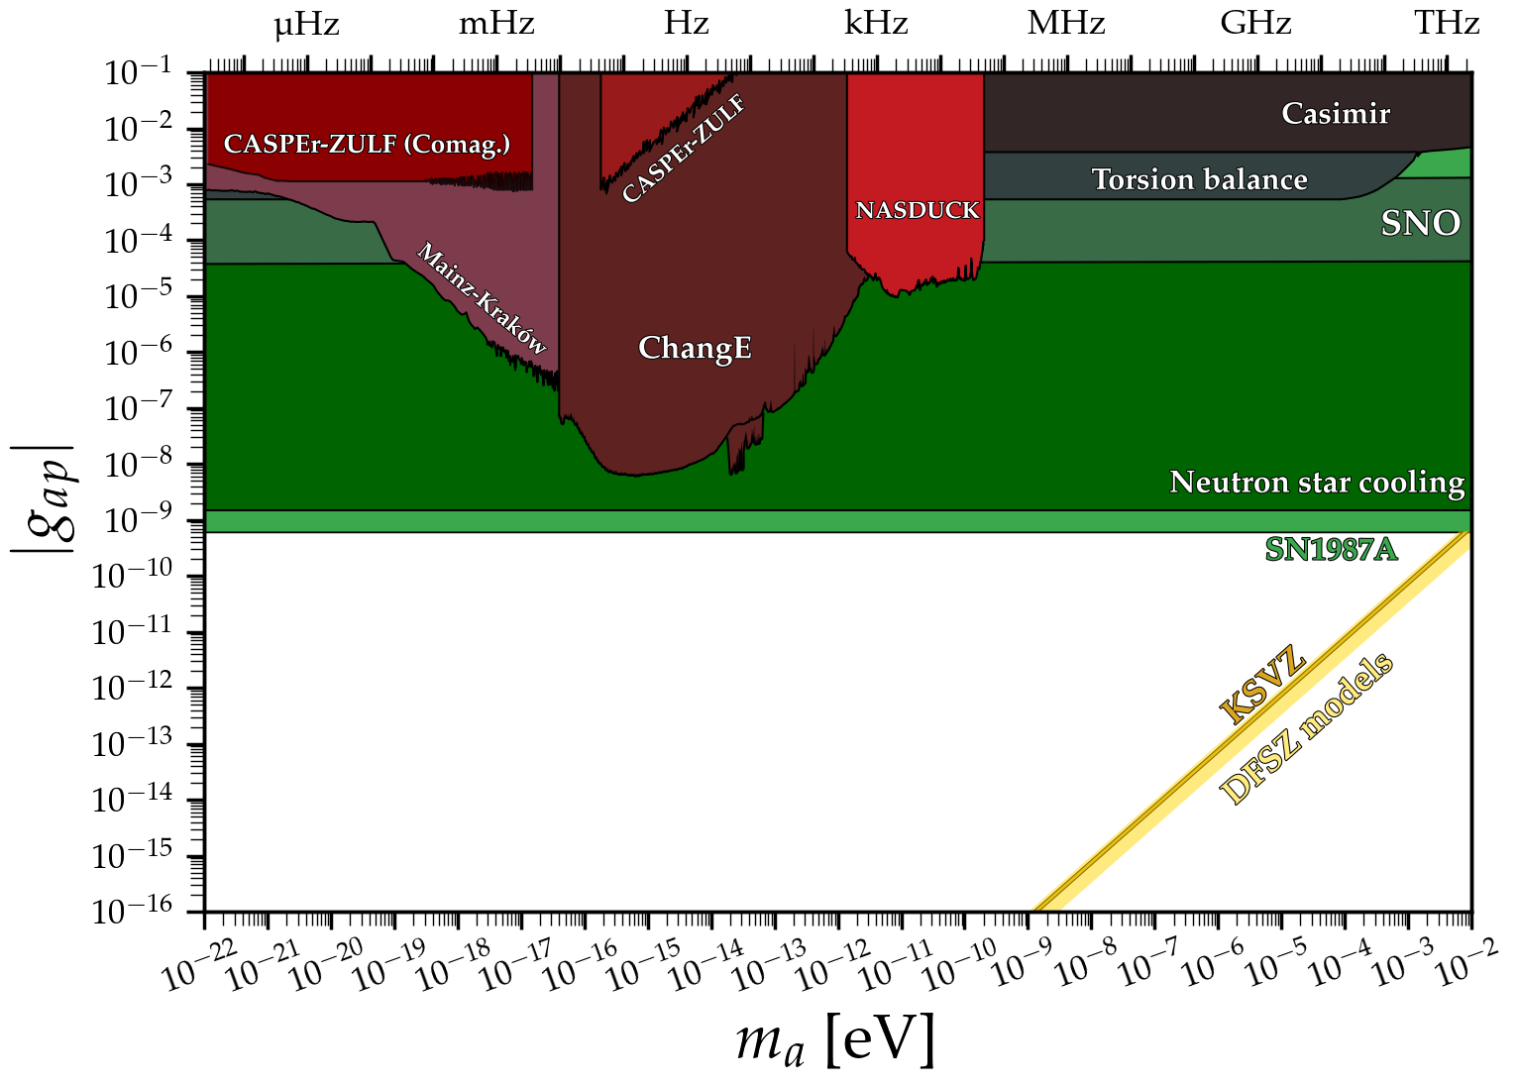
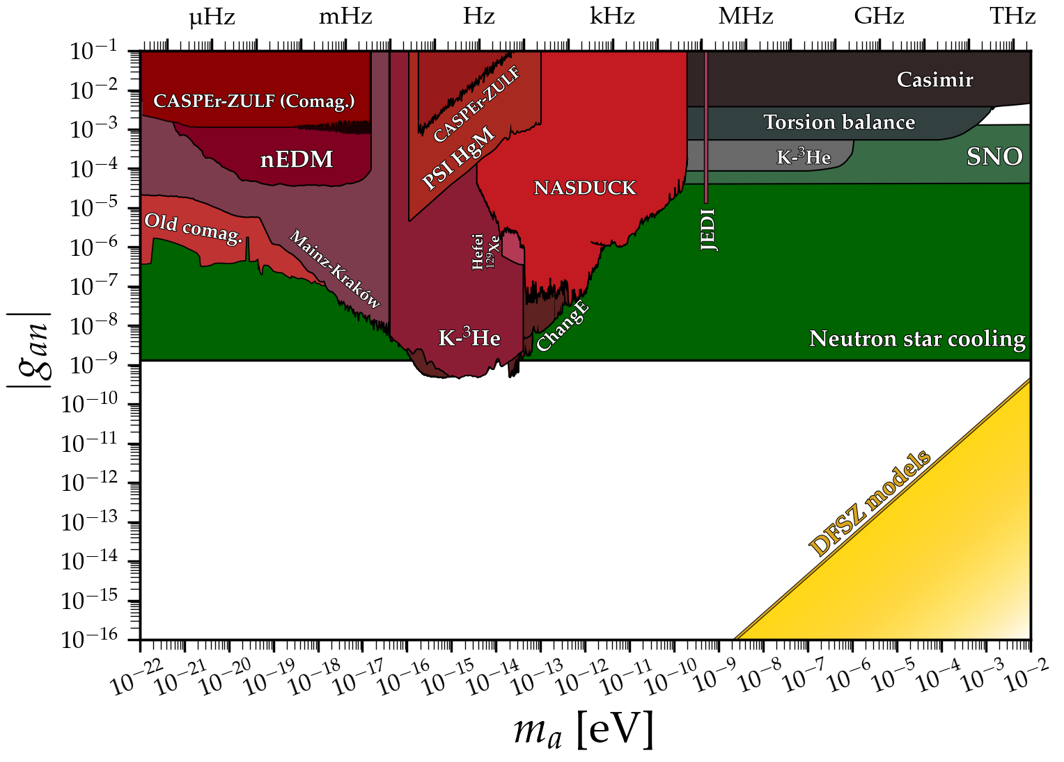
3. Nucleon interaction
Image: Ciaran O'Hare
(O’Hare 2024)

Slide 7
Isoscalar coupling
Isovector coupling
Nucleon isospin doublet
3. Nucleon interaction
⁵⁷Fe nucleus
³⁄₂⁺
14.4 keV
Photoexcitation
a
γ
Line axion emission
½⁺
Sun interior
Nuclear axion pump (M1)
Helioscopes
Image: NASA; CERN/Brice Maximilien
(Haxton & Lee 1991)

Slide 8
3. Nucleon interaction
Good: Distinct spectral profile after conversion into photon
Problem: Need odd-A isotopes to get a low-lying excited state, but Sun only has trace amounts of those from formation.
⁵⁷Fe nucleus
Problem: Hydrogen burning in the Sun occurs at 10⁷ K (1 keV), only thermally exciting one ⁵⁷Fe nucleus out of every million.
³⁄₂⁺
14.4 keV
Photoexcitation
a
γ
Line axion emission
½⁺
Nuclear axion pump (M1)
(Haxton & Lee 1991)

Slide 9
4. Another source
9 M⊙
¹H → ⁴He
~10⁷ years
⁴He → ¹²C, ¹⁶O
~10⁶ years
¹²C → ¹⁶O, ²⁰Ne, ²³Na, ²⁴Mg
~10³ years
(Limongi, Roberti, Chieffi & Nomoto 2023)

Slide 10
4. Another source
⁵⁄₂⁺
20% excited
³⁄₂⁺
1% excited
T ~ 40 keV
E = 440.2 keV
T ~ 1 keV
E = 14.4 keV
½⁺
³⁄₂⁺
Axion pump | ⁵⁷Fe in the Sun | ²³Na in evolved massive stars
Origin | Primordial | ¹²C + ¹²C → ²⁴Mg* → ²³Na + p
Abundance (M⊙) | ~ 0.003% | ~ 5%
Active lifetime | ~ few billion years | ~ few thousand years
Effective coupling | 0.0868 g_{app} + g_{ann} | g_{app} + 0.0638 g_{ann}

Slide 11

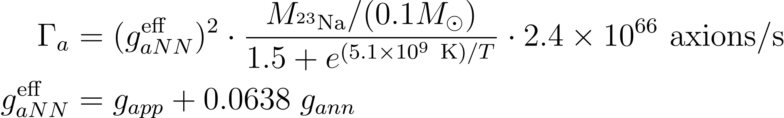
4. Another source
Abundance
Excited fraction

Slide 12
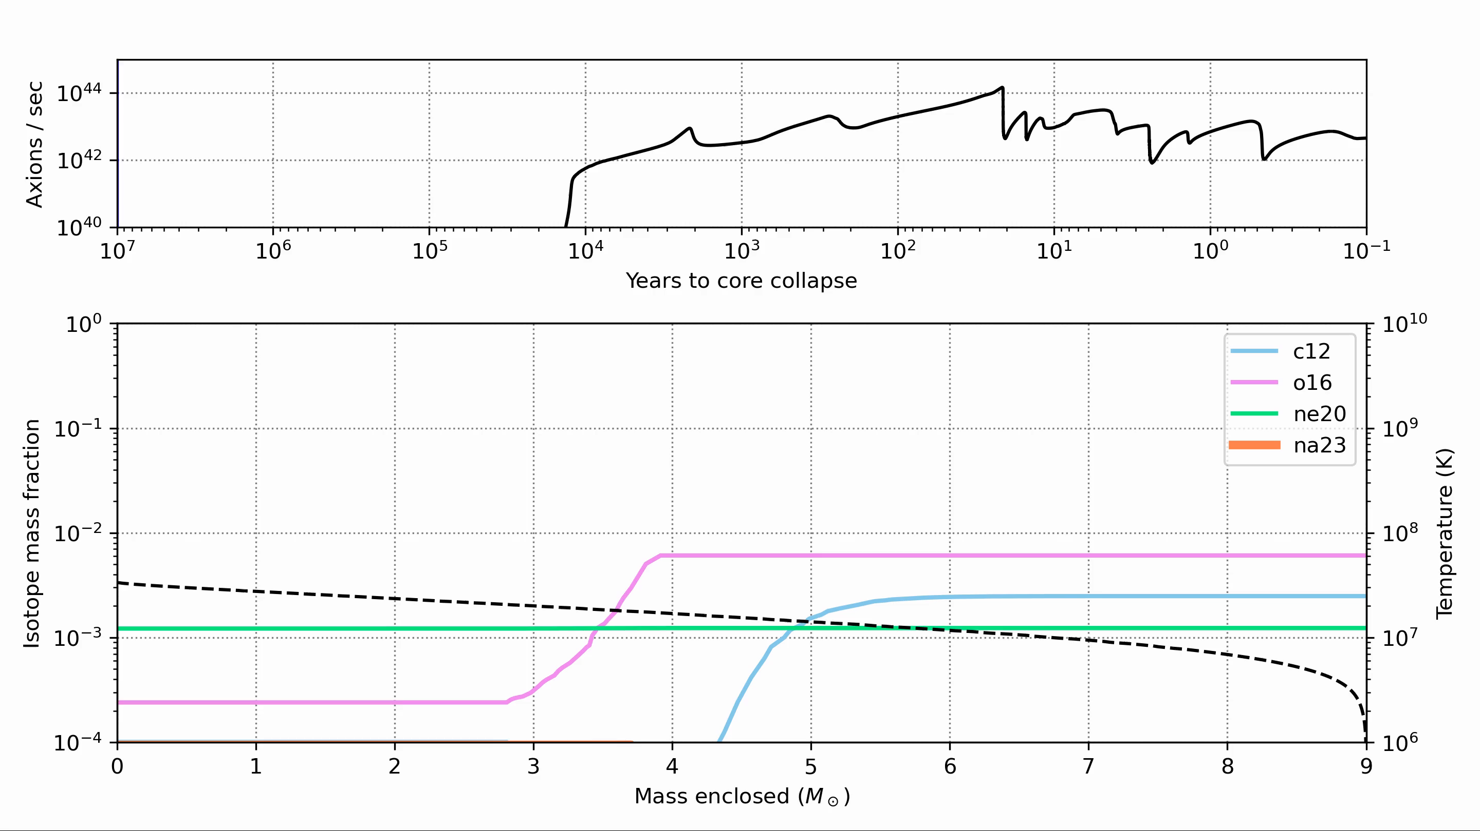

Slide 13
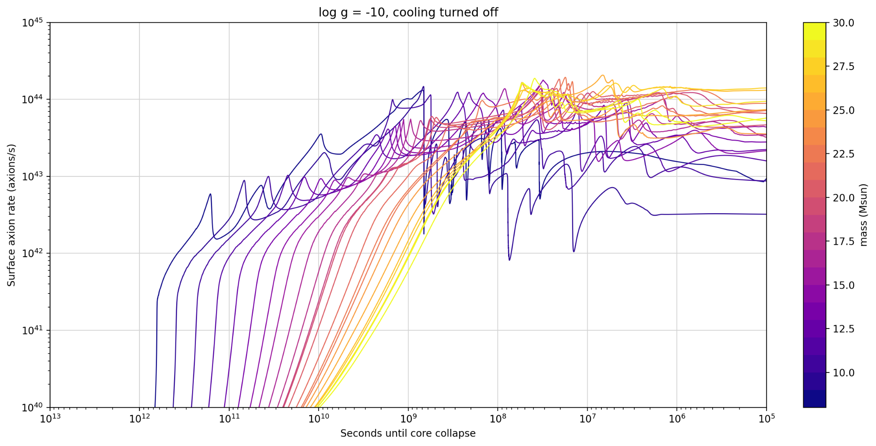
4. Another source

Slide 14
5. Detection
7.5 ~ 8.5 M⊙
Mass loss
O/Ne white dwarf
8.5 ~ 9.5 M⊙
Electron capture supernova
> 9.5 M⊙
Ne & Si burning
Direct collapse supernova
¹²C → ¹⁶O, ²⁰Ne, ²³Na, ²⁴Mg
~10³ years
Population of axion-producing stars in Milky Way constrained by average of one supernova every ~40 years, and one O/Ne white dwarf every ~175 years.
(Limongi, Roberti, Chieffi & Nomoto 2023)

Slide 15
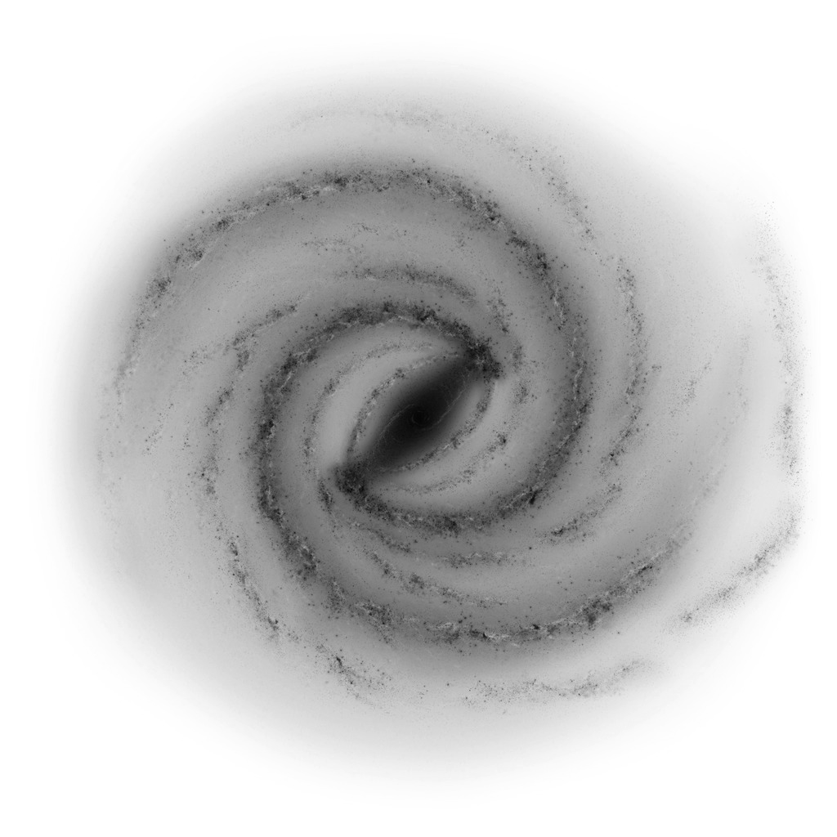
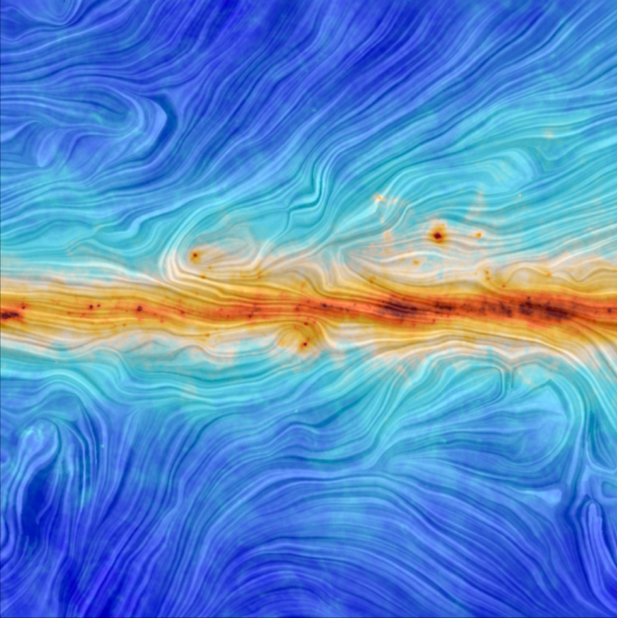
5. Detection
C-burning star
Conversion probability ~0.1%
Earth
Galactic magnetic field B ~ μG
Image: NASA/JPL-Caltech/R. Hurt; ESA/Planck/M.A. Miville-Deschênes
(Verberne & Vink 2021; Calore et al. 2024)

Slide 16
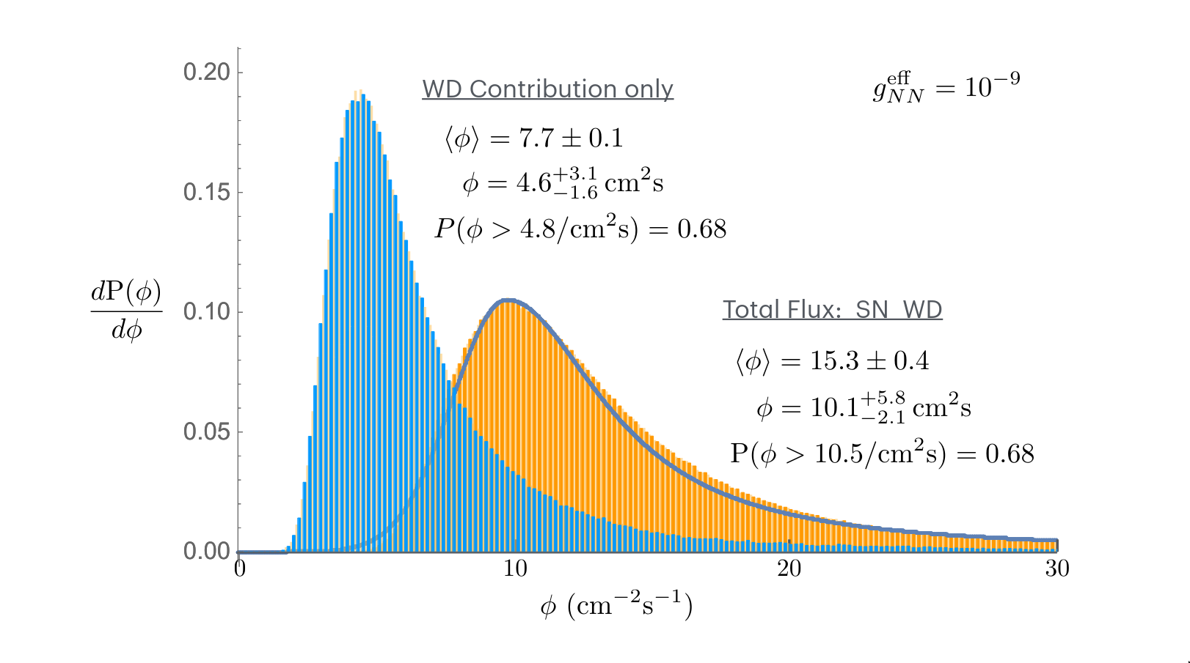
5. Detection
/
/
/
/
–

Slide 17
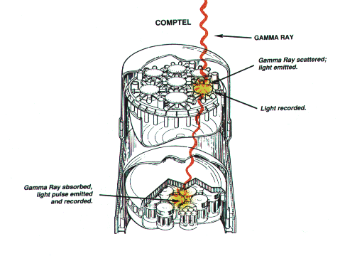
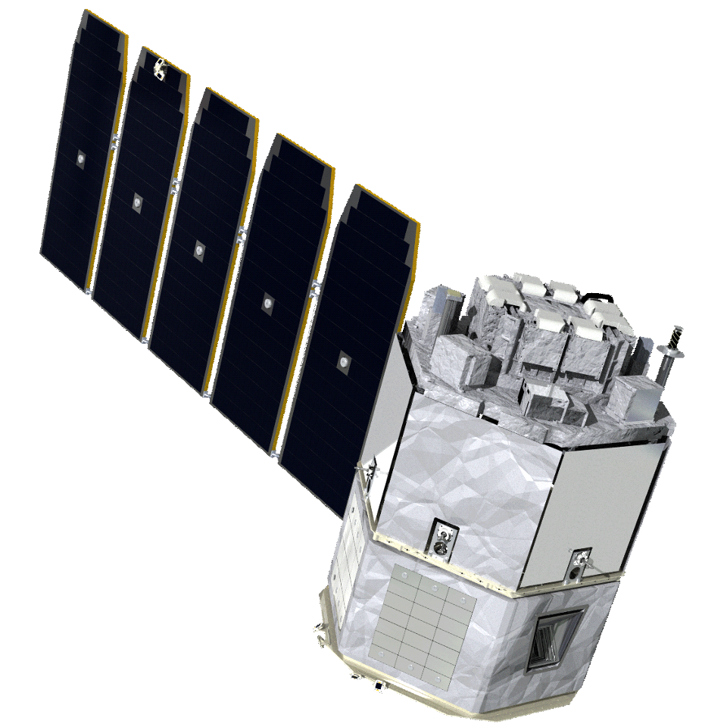
5. Detection
NASA/SSL Compton Spectrometer and Imager (COSI)
Line sensitivity >10^{–5} /cm² s at 511 keV
Image: COSI
(COSI collaboration 2023)

Slide 18
Acknowledgements
References
We are grateful to Steve Boggs, Chris Fryer, Georg Raffelt, and Josiah Schwab for helpful discussions, and to Annabelle McCutcheon for her initial work on MESA simulations.
XL would like to thank Bea Noether for teaching him particle physics, and the MESA team for making their software open-source. Our modified MESA code is available at github.com/xingyzt/saltyaxions.
WH acknowledges support by the US Department of Energy under grants DE-SC0004658, DE-SC0023663, and DE-AC02-05CH11231, the Na- tional Science Foundation under cooperative agreement 2020275, and the Heising-Simons Foundation under award 00F1C7. XL and AR are supported under the NSF cooperative agreement 2020275, the former as an N3AS undergraduate researcher.
By order of appearance,
Raffelt, LNP, 2008
Haxton and Lee, PRL, 1991
O’Hare, Zenodo, 2024
CAST collaboration, Nature, 2009
Limongi et al., ApJS, 2024
Verberne and Vink, MNRAS, 2021
Calore et al., PRD, 2024
COSI collaboration, PoS, 2023

Slide 19
X. Extra slides
We use the open-source Modules for Stellar Astrophysics (MESA) library to run 1D evolution code with a large nuclear reaction network (including electron capture) as well as mass loss from stellar winds.
We simulate stars in the initial mass range M_{ZAMS} = 8–30 M⊙ from main sequence until end of oxygen burning, or until white dwarf T_{core} drops below 10⁸ K (~10 keV) if oxygen ignition is not reached. We implement axion cooling effects as a neutrino-like heat loss term.
To calculate the expected axion contribution by initial mass, we sample the simulations by the Salpeter initial mass function ∝ M^{–2.35}.
(Paxton & collaborators 2018; This work)

Slide 20
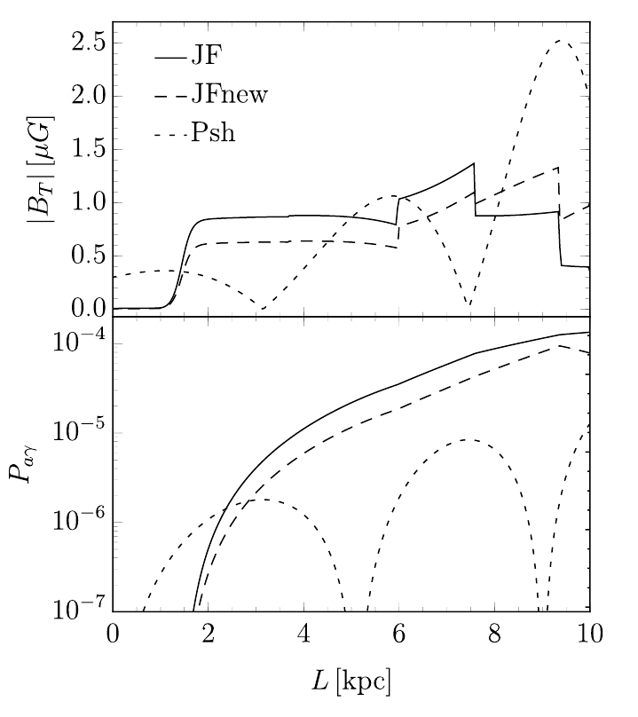
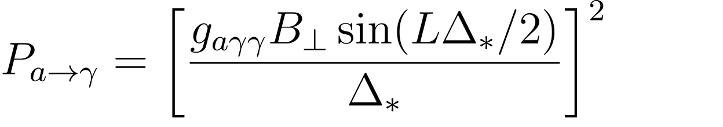
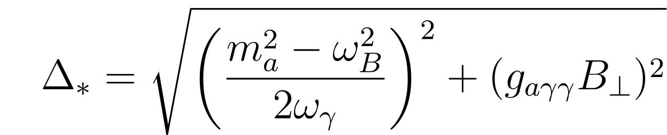
Transverse magnetic field strength ~μG
X. Extra slides
Conversion probability
Path length ~kpc
Level crossing oscillation frequency
Plasma frequency
Photon frequency (440 keV)
(Calore et al. 2024; Raffelt & Stodolsky 1988)

Slide 21
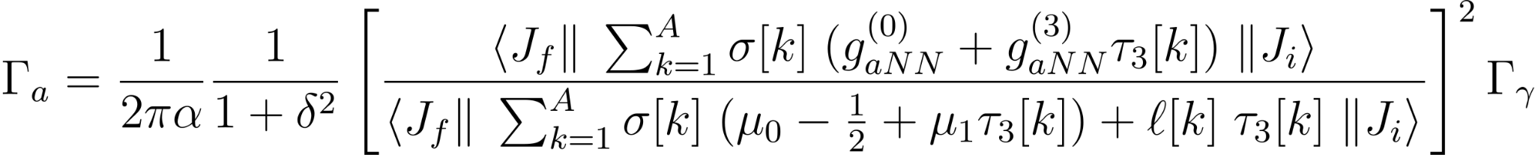
X. Extra slides
Sum over every nucleon
Axion channel rate
Total photon channel rate
Fraction of all photon channel decays that are via M1
Isoscalar nucleon magnetic moment
∝ protons + neutrons
~0.88
Isovector nucleon magnetic moment
∝ protons – neutrons
~4.71
(Haxton & Lee 1991)

Slide 22
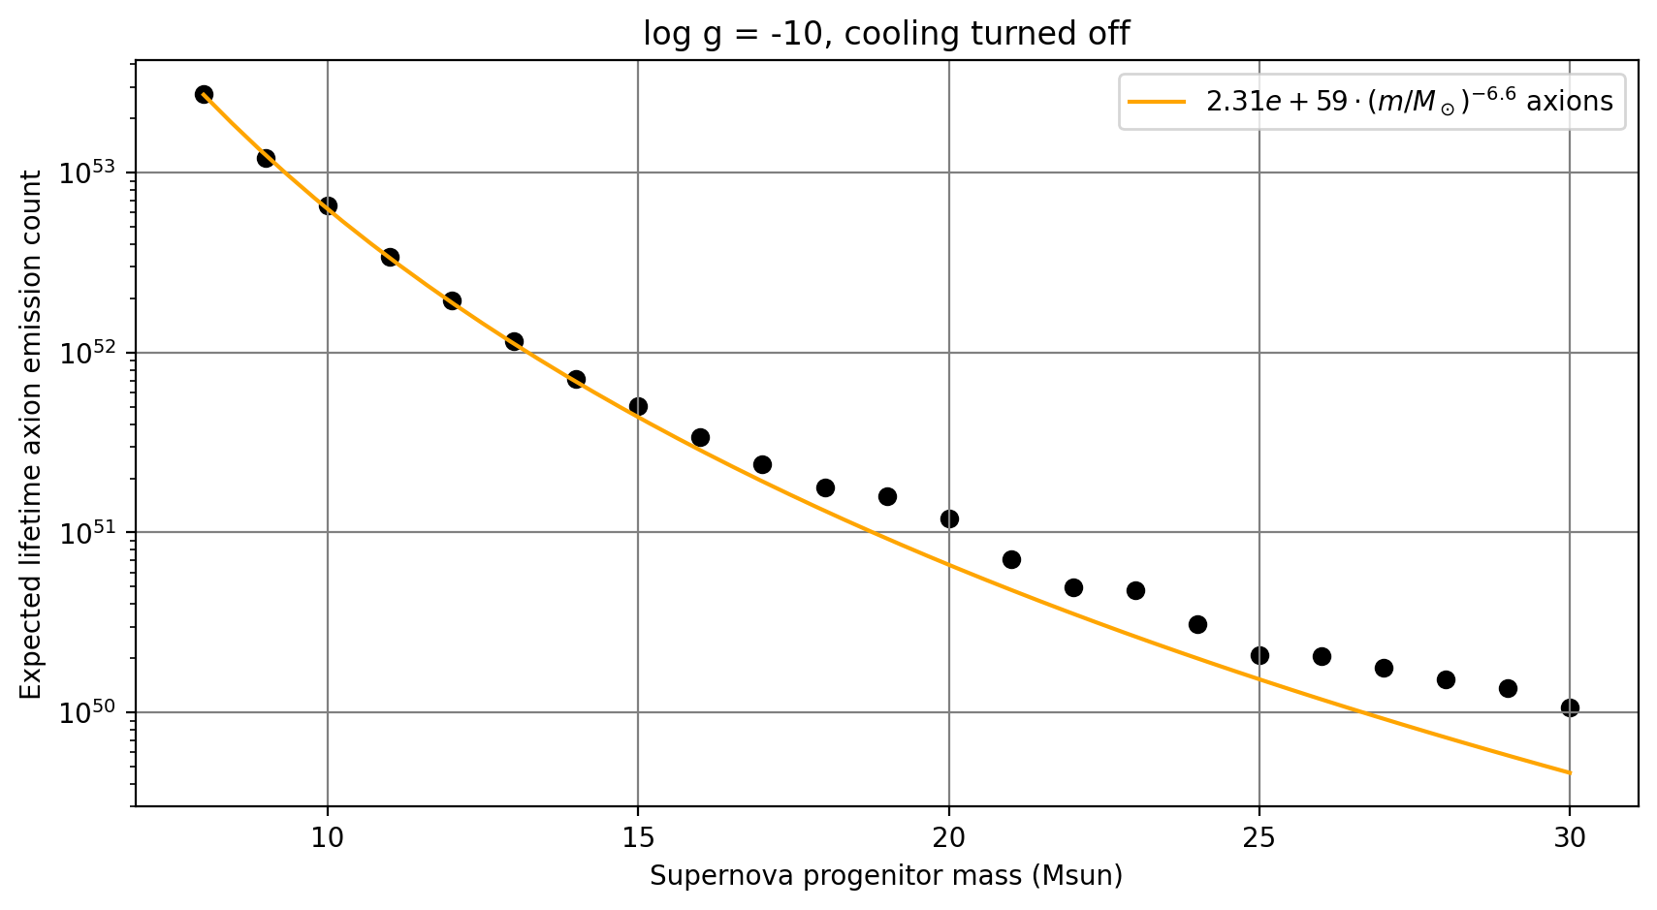
X. Extra slides

